Slide 1
ECG Classification Using Neural Networks
Sai Yadavalli
Machine Learning
May
2025

Slide 2
Content
1
Problem
2
Data
3
Algorithm
4
Training
5
Results
6
Future
Machine Learning
May
2025

Slide 3
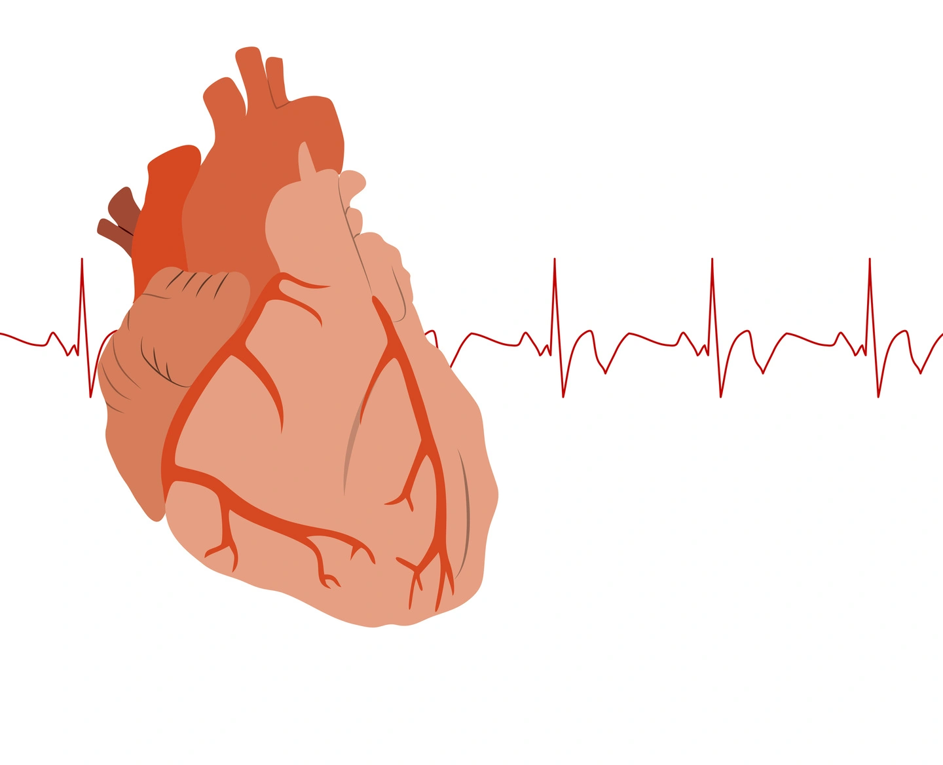
Problem
No way to automatically classify different types of heartbeats from ECG signals
End Goal: Early, accurate detection of arrhythmias, reducing the burden on healthcare professionals by providing automated diagnostic support.
Machine Learning
May
2025

Slide 4
109446
Data Description
187
5
Source
rows/samples (training + validation)
MIT-BIH
Arrhythmia Dataset
PhysioNet
Kaggle
Features: 187 values per heartbeat (ECG signal over time)
Each sample is a 1D vector representing a fixed-length ECG waveform segment.
Labels: Normal → 0, Supraventricular ectopic → 1, Ventricular ectopic → 2, Fusion → 3, Unknown → 4
Link to Kaggle Data Set
Machine Learning
May
2025

Slide 5
Convolutional Neural Network (CNN) Model
Our values
1
2
3
Implementation
1D Convolution layer extracts local ECG patterns
Max pooling reduces feature dimensionality
Softmax layer for probability output
ReLU activation and backpropagation—manually implemented
Architecture (Fully Connected)
Conv → Pool → Dense → Output
Libraries
Implemented from scratch in NumPy—no deep learning libraries used
Pandas for data processing
Scikit-Learn for metrics
Machine Learning
May
2025

Slide 6
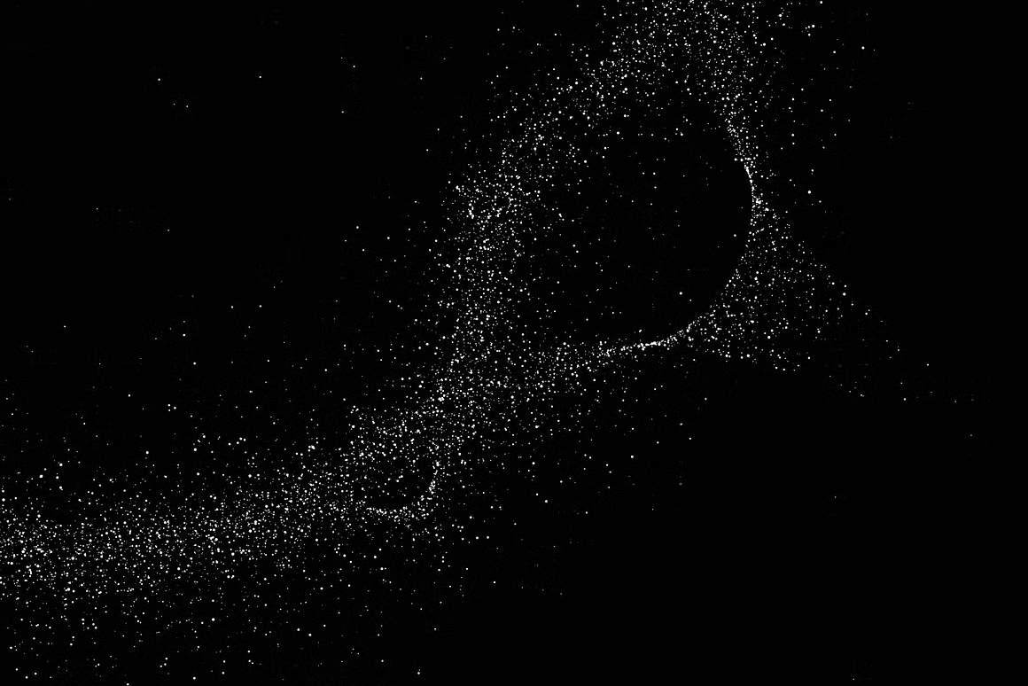
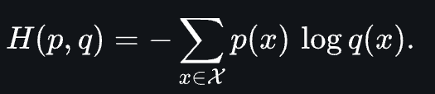
Data was split into…
Manual implementation of…
Training & Testing
80% Training
20% Testing/Validation
Not Standardized
Forward and backward passes
Stochastic gradient descent
Loss: Cross-Entropy
Machine Learning
May
2025

Slide 7
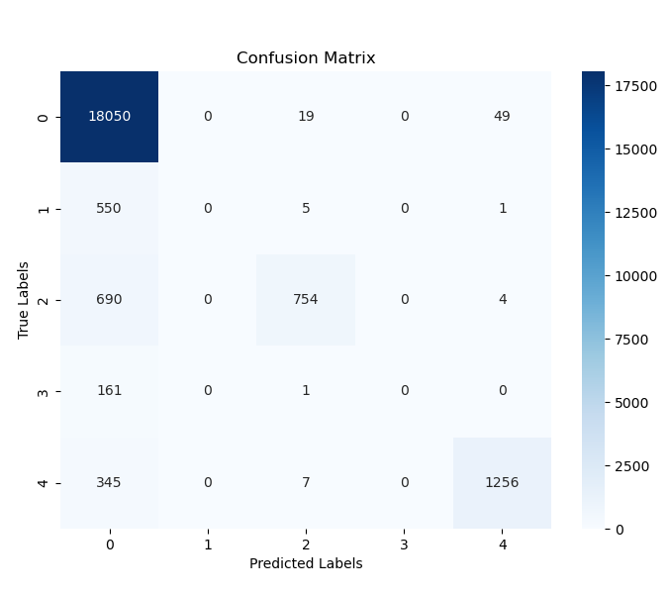
Results & Evaluation
Let’s work together
Evaluated on test set using classification metrics:
Accuracy: 91.63%
Precision: 88.85%
Recall: 91.63%
F1 Score: 89.59%
Machine Learning
May
2025

Slide 8
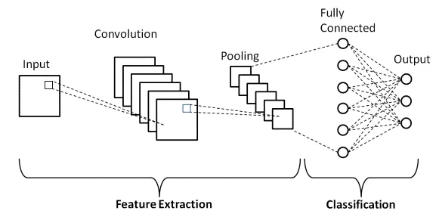
What Did I Learn?
Our mission
Even simple CNNs can achieve strong performance on time-series data in Arrhythmia Classification
Implementing backpropagation, training logic, and loss function deepened understanding of ML fundamentals
Future improvements:
Add more layers
Adjust Parameters
conv_filters=6, kernel_size=5, pool_size=2, hidden_units=32, learning_rate=0.01, epochs=10, batch_size=32
Try Scaling
Machine Learning
May
2025

Slide 9
Thank you
Any Questions?
Machine Learning
May
2025

